Slide 1
Cross Product Sentiments in Airline Industry
By
Vincent Zhang
Kaushik Jayaram
Phi Hoang

Slide 2
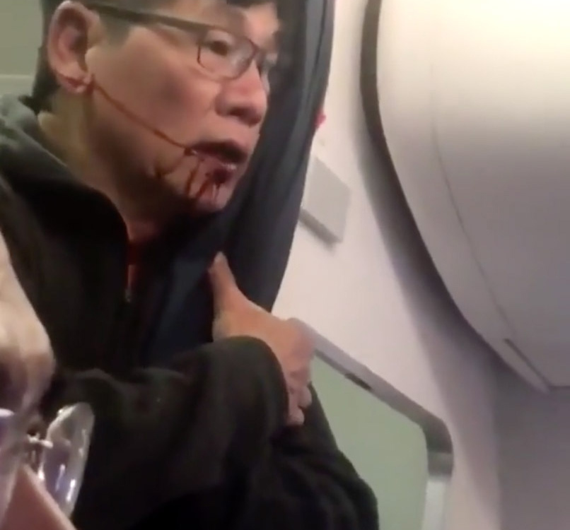
Do you remember this event?

Slide 3
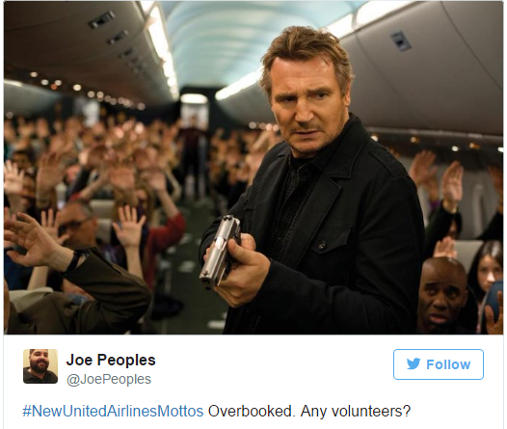
Tweets after the news
"United Airlines. Putting the hospital in hospitality“
"Sit back, relax, and enjoy your fight."#NewUnitedAirlinesMottos
We'll beat any price and any customer. #NewUnitedAirlinesMottos
Ladies and gentleman, we have now reached bruising altitude... #NewUnitedAirlinesMottos
And our favorite…

Slide 4

What happens after such events?
Negative customer sentiments
Bad reviews
It is likely that Facebook, Twitter, YouTube, review sites, forums, and blogs are all highly correlated with each other, and with the dependent variable, sales
This will impact sales
If I am a manager of American Airlines, what can I get?.....

Slide 5
Previous literature
Duan et al (2008) find that increased WOM on Yahoo!Movie (a movie review site) lead to higher movie box office performance.
Bollen et al (2010) found that twitter moods can predict stock market performance.
Some consumers feel oppositional loyalty towards certain brands, which they express through purchase behavior, negative behavior towards admirers of other brands, and “trash talking” (Hickman and Ward 2007; Thompson and Sinha 2008; Thompson, Kim and Smith 2016).

Slide 6
Data
We collected customer tweets data about the nation’s major airlines (namely, United Airline, Virgin America, and American Airline) from two different sources ) – Kaggle and twitter data after the event
Kaggle:
There are 11,222 unique tweets from 11,222 distinct Tweeter IDs, with a timeframe from 2/16/2015 through 2/24/2015.
In terms of sentiment, 60% of the tweets were classified as positive, 23% neutral, and 17% positive.
Twitter:
We scraped textual data covering three major airlines to be concerned: United Airline, American Airline, and Virgin Airline.
. 51,906 tweets were collected from 51,906 distinct Tweeter IDs, with a timeframe from 4/11/2017 through 4/19/2017.

Slide 7
Method
In step 1, to get sentiment data, we first utilize Naïve Bayes method in the realm of machine learning to create a textual sentiment classifier.
In step 2, we applied the classifier to the twitter Dataset to analyze the dispersion of customers’ sentiment on the three major airlines.
In our case, for example, if a ‘tweet’ attribute had the values ‘love’ and “hate” and the class attribute had the class values “positive” and “negative“, then the conditional probabilities of each tweet value for each class value could be calculated as:

Slide 8
Summary - % of reviews across airlines

Slide 9
Summary - % of positive vs negative reviews

Slide 10
Elasticity

Slide 11
Summary
From the table above we find that the percentage of negative reviews for United airlines have been quite high from the 11th of April and this is attributed to the negative event that occurred with the passenger.
On average 67% tweets for United everyday and around 30% for American airlines.
On average, found that the elasticity of positive reviews was 1.29 which is > 0 and implies that the airlines are substitutes.
Best time for American Airlines manager to get positive sentiment towards own brand is between 11th and 16th

Slide 12
References
Duan, W., Gu, B., & Whinston, A. B. (2008). The dynamics of online word-of-mouth and product sales-An empirical investigation of the movie industry. Journal of Retailing, 84(2), 233-242.
Bollen, Mao, and Zeng. "Twiter Mood Predicts the Stock Market." Journal of Computational Science. 2011.
Scott A. Thompson, Rajiv K. Sinha (2008) Brand Communities and New Product Adoption:The Influence and Limits of Oppositional Loyalty. Journal of Marketing: November 2008, Vol. 72, No. 6, pp. 65-80.
Thomas Hickman and James Ward (2007) ,"The Dark Side of Brand Community: Inter-Group Stereotyping, Trash Talk, and Schadenfreude", in NA - Advances in Consumer Research Volume 34, eds. Gavan Fitzsimons and Vicki Morwitz, Duluth, MN : Association for Consumer Research, Pages: 314-319.

